Slide 1
Inverting amplifier
Isaiah Marin

Slide 2
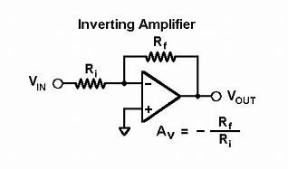
Introduction
The inverting amplifier circuit is a commonly used circuit in electronics and signal processing applications. It amplifies the input signal while inverting its polarity. This presentation will describe the function of the circuit, its applications, advantages, disadvantages, and variations.

Slide 3
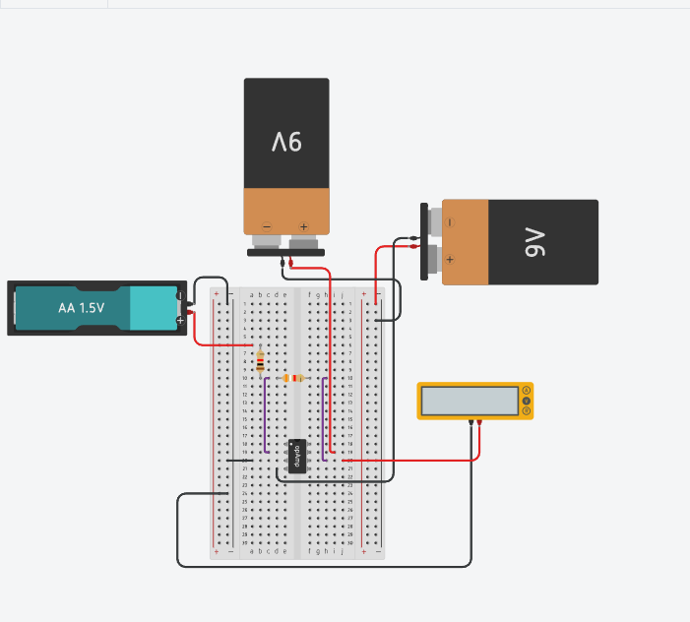
Circuit description
The inverting amplifier circuit consists of two resistors and an operational amplifier (741). The input signal is connected to the inverting input terminal of the operational amplifier. The feedback resistor connects the output to the inverting input. This configuration amplifies the input signal while inverting its polarity. The resistor values determine the gain of the circuit.

Slide 4
Application
The inverting amplifier circuit finds applications in various fields. It is commonly used in audio amplifiers, signal conditioning circuits, and instrumentation amplifiers. Its versatility allows it to be used in both analog and digital circuits. The circuit is particularly useful in scenarios where signal inversion is required or where precise amplification and signal conditioning are necessary. m

Slide 5
Advantages
The inverting amplifier circuit offers several advantages. It has a high input impedance, minimizing the loading effect on the input signal source. The gain of the circuit can be easily adjusted by changing resistor values, providing flexibility in amplification. Additionally, the circuit has a low output impedance, enabling it to drive low impedance loads effectively

Slide 6
Disadvatagess
There are a few disadvantages associated with the inverting amplifier circuit. The most notable drawback is the signal inversion, which may not be desirable in certain applications. Additionally, the output voltage range is limited by the power supply voltages, which can restrict the maximum output swing.

Slide 7
Circuit Variations
The inverting amplifier circuit can be modified to suit specific requirements. One variation involves adding a capacitor for frequency response shaping, allowing for tailored frequency characteristics. Another option is to introduce a potentiometer to provide adjustable gain, providing flexibility in amplification settings. These variations demonstrate the adaptability of the inverting amplifier circuit to different application needs.

Slide 8
References
1. Sedra, A. S., & Smith, K. C. (2004). Microelectronic circuits (5th ed.). Oxford University Press.
2. Horowitz, P., & Hill, W. (2015). The art of electronics (3rd ed.). Cambridge University Press.
3. Op Amp Applications Handbook. (2005). Texas Instruments.
4. Gray, P. R., Hurst, P. J., Lewis, S. H., & Meyer, R. G. (2001). Analysis and design of analog integrated circuits (5th ed.). Wiley.
5. Floyd, T. L., & Buchla, D. M. (2020). Electronics fundamentals: A systems approach (9th ed.). Pearson.

